Slide 1




The Certification of HIV Rapid Testing Non-Laboratory Testers: A Case Study of Successful Program Escalated by Project ECHO
Authors: Magreth Antony¹, Zubeda Salum², Cosmas Muya¹, Solomon Mwaigwisya¹, Mary Mtui², Ferdinand Matata³, Omary Mbwambo², Simon Gamaya² Emmanuel Mtete⁴, Lilian Shija⁴, Amani Shao¹, Nzovu Ulenga¹David Sando¹, David Temba¹
Affiliation: 1. Management and Development for Health, Dar es Salaam, Tanzania 2. Ministry of Health, Dodoma-Tanzania 3. President's Office, Regional Administration and Local Government Tanzania (PO-RALG), 4. Division of Global HIV and TB, U.S. Centers for Disease Control and Prevention, Tanzania.
Presenter: Magreth Antony

Slide 2
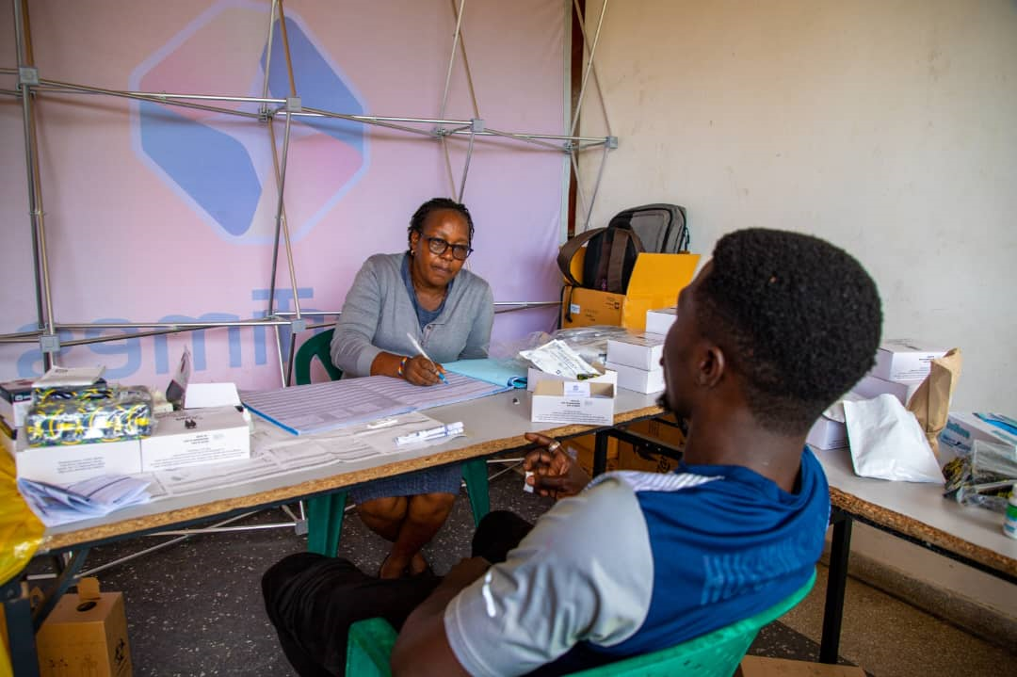
Presentation Outline
1. Introduction
2. Methodology
3. Results
4. Conclusion
5. Recommendations
6. Acknowledgment

Slide 3
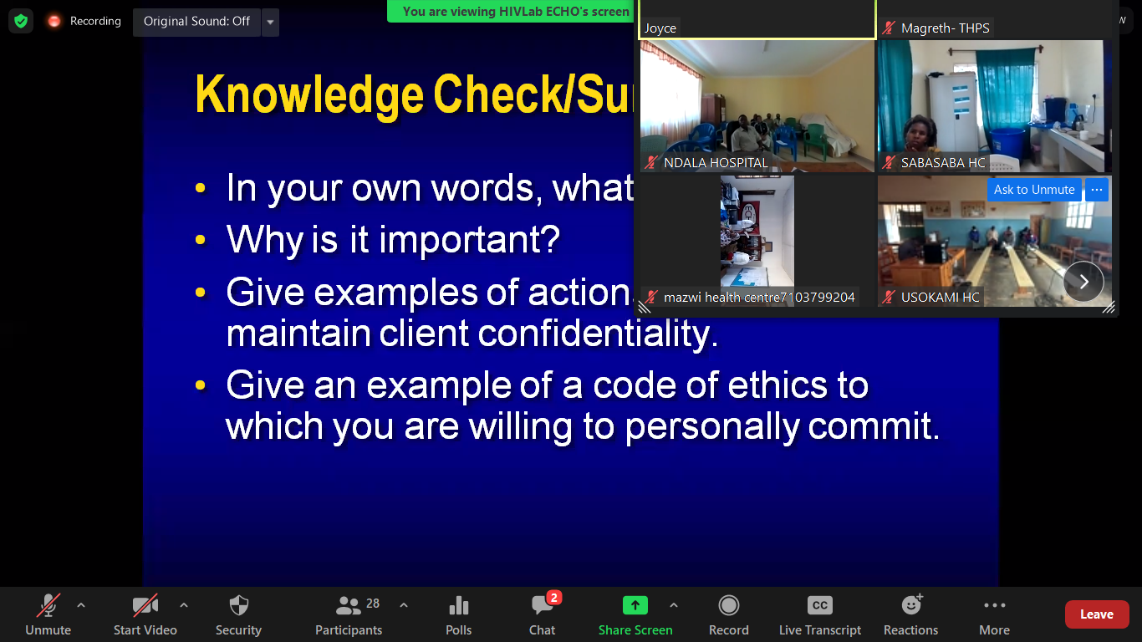
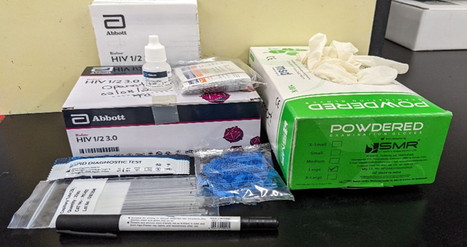
Introduction
UNAIDS' goal of identifying 95% of HIV cases for epidemic control is reliant on having testing competencies.
Tanzania introduced the project ECHO training model in 2016 to address the shortage of skilled, qualified, and certified rapid HIV testers.
Previously, the training was conducted in classes, and in most facilities same participants were attending training given the primary objective of getting Incentives which caused the low coverage of Certified Testers.
However, there remains a notable dearth of describing the program's success.
This study delves into the success of expediting non-laboratory HIVRT tester certification through the ECHO Training program.
Methodology
A retrospective analysis utilized national non-laboratory HIVRT tester data from the i- ECHO database and MOH annual program reports from 2018 to 2023 to compare the progress of Testers Trained, Eligible for Competency assessment, Assessed and Certified.
Descriptive analyses tracked the annual growth of non-laboratory HIVRT testers' training and certification.

Slide 4
Results
ECHO modality contributed to 47% of Certified Testers compared to 8% from In-class training, which shows a yield of 34% greater than by comparing the progress of 4 years consecutively.
Between Jan- 2019 to Dec-2022, a total of 22,318 HIVRT testers were trained, with 9,597 (43%) achieving certification compared to 2,909 Trained Testers through In-class and 1,932 (66%) achieving certification between Jan-2028- Dec 2021 across 26 regions of Tanzania.
From baseline to follow-up
A significant rise of testers with complete training remarked from 2,933 (12%) in 2019 to 14,524 (58%) in 2022.
33% increase in certified testers from 1,322 (5%) in 2019 to 9,597 (39%) in 2022.
Identified dominant challenges being incomplete training (35%) and inadequate pass marks (20%).

Slide 5
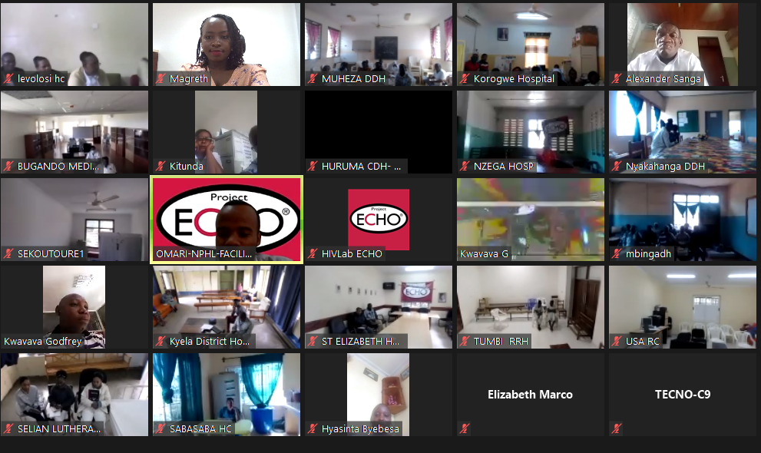
Conclusion
Effective utilization of the Project ECHO approach can rapidly accelerate the capacitation and certification of the non-laboratory HIVRT testers as appreciated to be cost-effective, and less time-consuming.
Recommendations
This approach should be scaled up to reach remain untrained and uncertified Testers) to ensure sustainable quality assurance practices that lead to accurate and reliable testing results and improved public health outcomes.

Slide 6
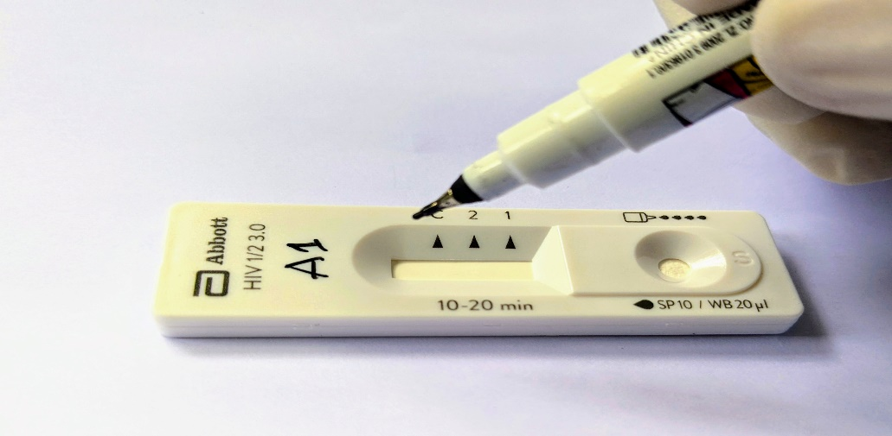
Acknowledgment
The findings and conclusions in this presentation are those of the author(s) and do not necessarily represent the official position of the funding agencies. This Lab For Health project has been supported by the U.S. President’s Emergency Plan for AIDS Relief (PEPFAR) through the Division of Global HIV and TB, U.S. Centers for Disease Control and Prevention, Tanzania (CDC) and Management Development for Health (MDH) under the Cooperative Agreement (GH002126). The authors have no relevant financial relationships with ineligible companies to disclose.

